Slide 1
Performance Evaluation of MLT in Web Page Load Time Prediction (Part 2: java classes used)
Raghu Ramakrishnan
(You can reach us at raghuramakrishnan71@gmail.com for queries or help with the scripts)
Arvinder Kaur

Slide 2
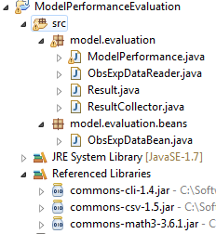
model.evaluation.ModelPerformance (project structure)
model-eval.jar

Slide 3
model.evaluation.ModelPerformance (classes)
ObsExpDataBean
Abstraction for instance identifier, observed and expected value of a data point
ObsExpDataReader
Reads and returns an ArrayList of ArrayList of ObsExpDataBean. There are k sets of data points in case of k-fold validation (each set starts with instance identifier 1).
Result
Abstraction for model accuracy values
ResultCollector
Abstraction for set of Results
ModelPerformance
Main class which outputs the various accuracy values for each model.
Dependencies
commons-cli-1.4.jar, commons-csv-1.5.jar, commons-math3-3.6.1.jar

Slide 4
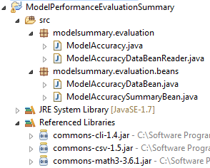
modelsummary.evaluation.ModelAccuracy (project structure)
model-eval-summary.jar

Slide 5
model.evaluation.ModelPerformance (classes)
ModelAccuracyDataBean
Abstraction for model accuracy values
ModelAccuracySummaryBean
Abstraction for accuracy values of the best performing model
ModelAccuracyDataBeanReader
Reads and returns an ArrayList of ModelAccuracyDataBean
ModelAccuracy
Main class which identified and outputs the accuracy values for best performing model.
Dependencies
commons-cli-1.4.jar, commons-csv-1.5.jar, commons-math3-3.6.1.jar

Slide 6
Packaging
Work in progress: The package plt-java.zip is in the process of being created!

